Slide 1



BigData – Hadoop
Manish Singh.

Slide 2

What is
???

Slide 3
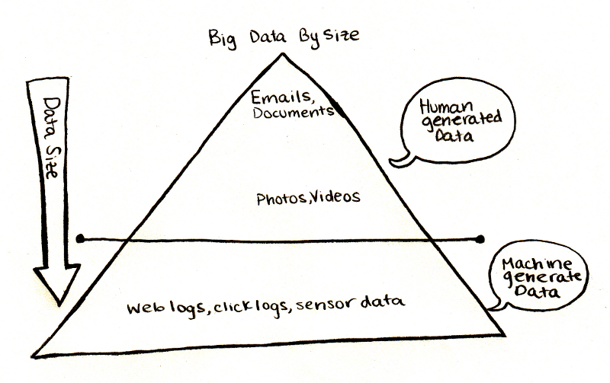
BIG DATA-BIG VALUE
Human Generated Data and
Machine Generated Data

Slide 4
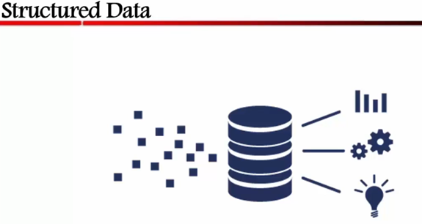
Types of Data

Slide 5
SemiStructured Data
Semi Structured Data is a Form of Structured Data that Doesn’t Conform with the Formal Structure of data models associated with Relational DataBase.
Ex: XML Data
JSON Data
Log Files

Slide 6
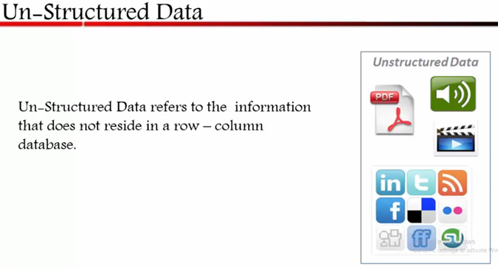

Slide 7
What is Big Data?
What makes data, “Big” Data?

Slide 8
Big Data Definition
No single standard definition…
“Big Data” are the collection of data sets so large and complex that it becomes difficult to process using on hand database management tools or traditional data processing Application.
Tom White

Slide 9
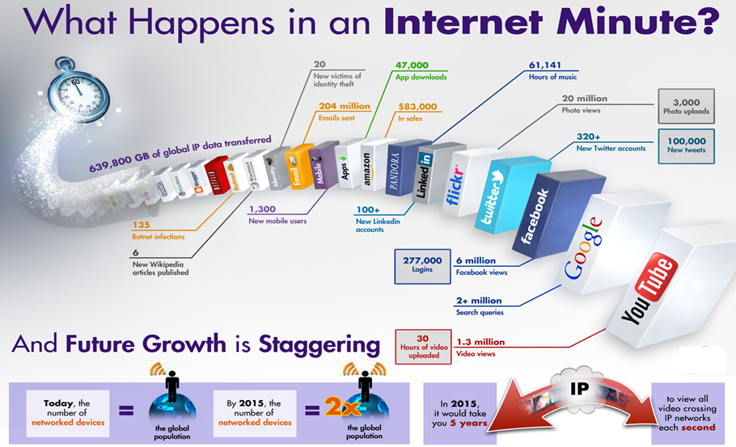
Where does Big Data come from

Slide 10

Theme of this Course
Large-Scale Data Management
Big Data Analytics
Data Science and Analytics
How to manage very large amounts of data and extract value and knowledge from them

Slide 11
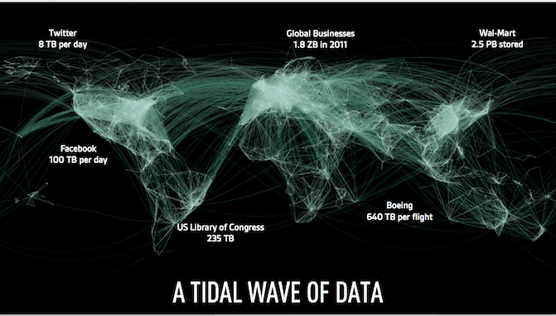
Examples of Big Data in the Real world
Facebook : has 40 PB of data and captures 100 TB / day
Yahoo : 60 PB of data
Twitter : 8 TB / day
EBay : 40 PB of data, captures 50 TB / day

Slide 12






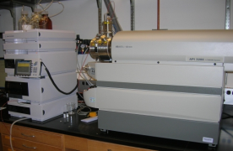
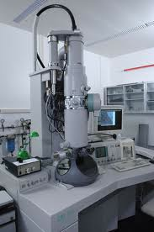
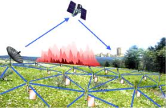

Who’s Generating Big Data
Mobile devices
(tracking all objects all the time)
Social media and networks
(all of us are generating data)
Scientific instruments
(collecting all sorts of data)
Sensor technology and networks
(measuring all kinds of data)
The progress and innovation is no longer hindered by the ability to collect data
But, by the ability to manage, analyze, summarize, visualize, and discover knowledge from the collected data in a timely manner and in a scalable fashion

Slide 13
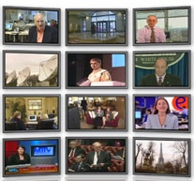



The Model Has Changed…
The Model of Generating/Consuming Data has Changed
Old Model: Few companies are generating data, all others are consuming data
New Model: all of us are generating data, and all of us are consuming data

Slide 14
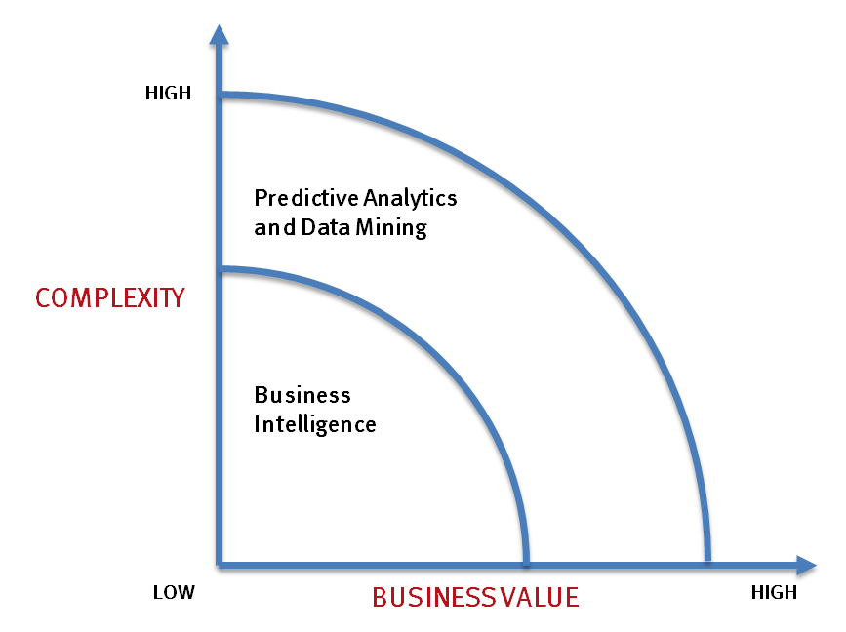
What’s driving Big Data
- Optimizations and predictive analytics
- Complex statistical analysis
- All types of data, and many sources
- Very large datasets
- More of a real-time
- Ad-hoc querying and reporting
- Data mining techniques
- Structured data, typical sources
- Small to mid-size datasets

Slide 15
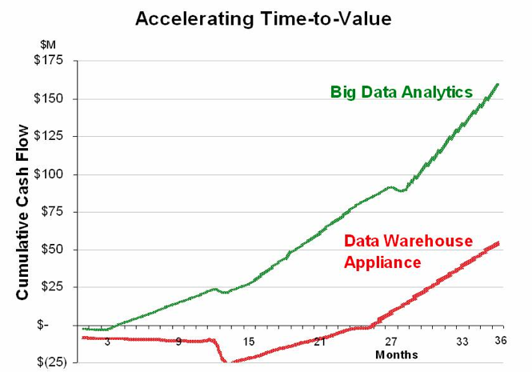
Value of Big Data Analytics
Big data is more real-time in nature than traditional DW applications
Traditional DW architectures (e.g. Exadata, Teradata) are not well-suited for big data apps
Shared nothing, massively parallel processing, scale out architectures are well-suited for big data apps

Slide 16
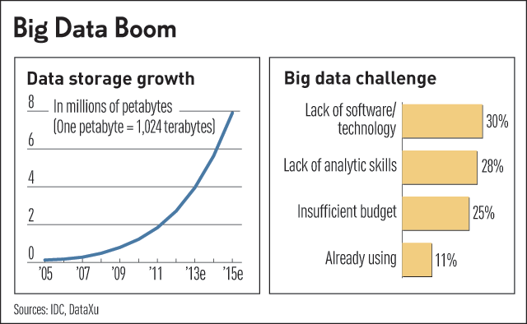
Challenges in Handling Big Data
The Bottleneck is in technology
New architecture, algorithms, techniques are needed
Also in technical skills
Experts in using the new technology and dealing with big data

Slide 17









Slide 18
Data Statistics : Total activity
IDC estimates the total volume of data is 4.4 zeta Bytes in 2013.
By 2020 this value will reach to 44 ZETTA BYTES
1000 Mega Bytes = 1 GB
1000 GIGABYTES = 1TB
1000 TERABYTES = 1PB
1000 PETABYTES = 1EB
1000 EXABYTES -1 ZETABYTE

Slide 19
Flood of Data Comes from :-
New York Stock Exchange generates about 4-5 terabytes of data Per Day.
Facebook hosts more than 240 billion photos, growing at 7 Petabytes per Month.
Internet Archive Stores around 18.5 Petabytes of Data.
Ancestry.com stores around 10 Petabytes of Data.

Slide 20
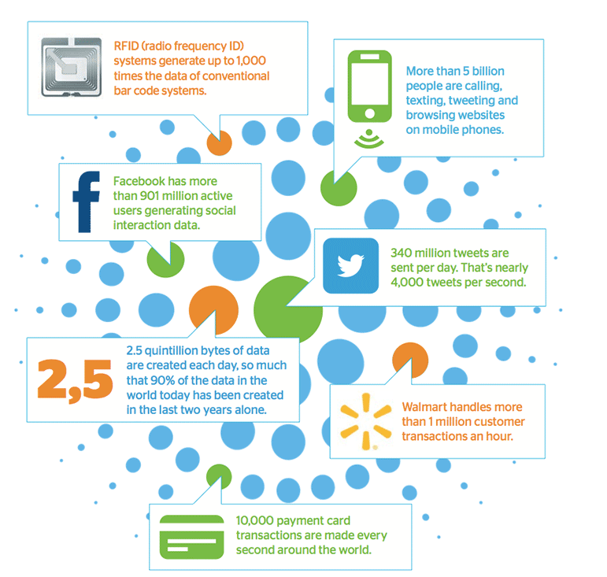

Slide 21
DO YOU KNOW ??
“90% of the world’s data was generated in the last few years.”
The amount of data produced by us from the beginning of time till 2003 was 5 billion gigabytes.
The same amount was created in every two days in 2011, in every ten minutes in 2013 , in every 6 minutes in 2016.

Slide 22
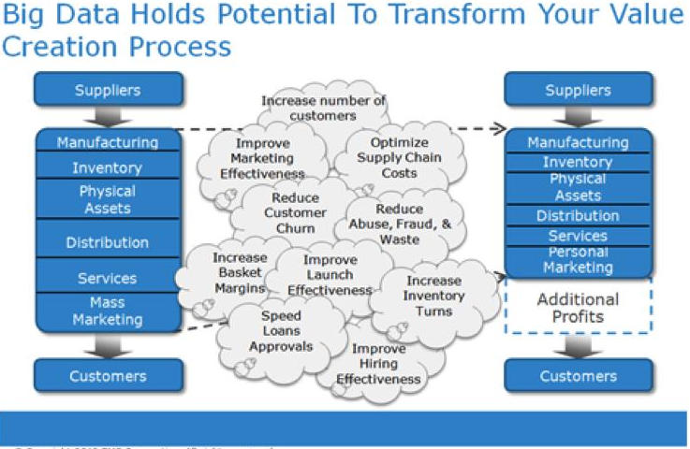

Slide 23
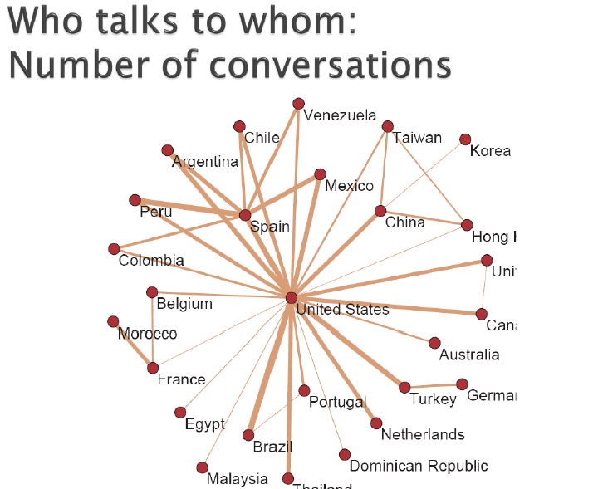

Slide 24
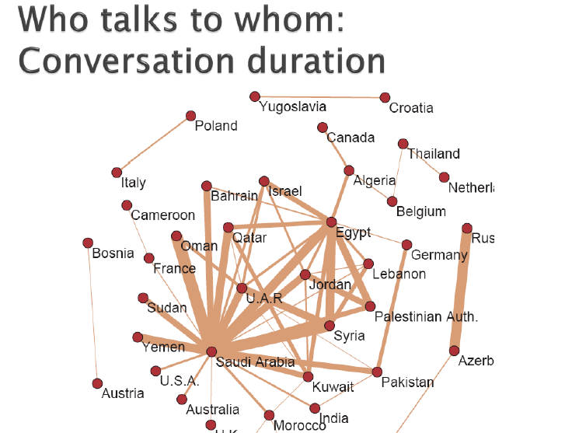

Slide 25
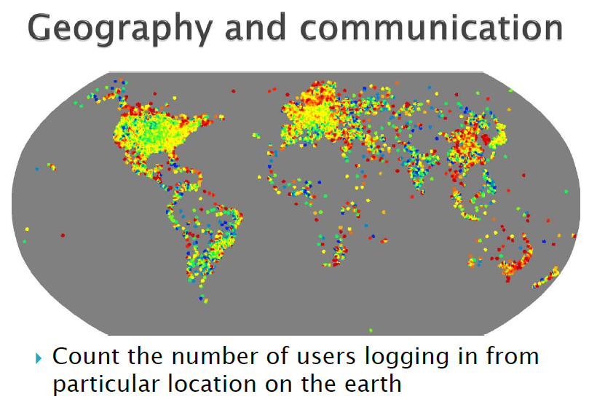

Slide 27
Challenges of Big Data
Sheer size of Big Data
Big Data is unstructured or semi structured

Slide 28
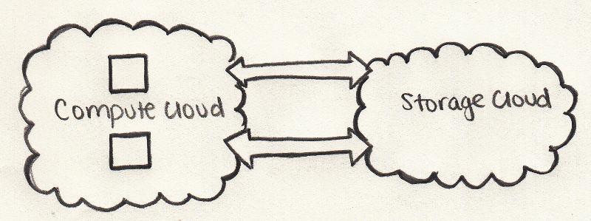
No point in just storing big data, if we can't process it
Traditional system

Slide 29
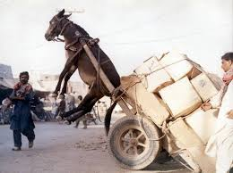

Slide 30
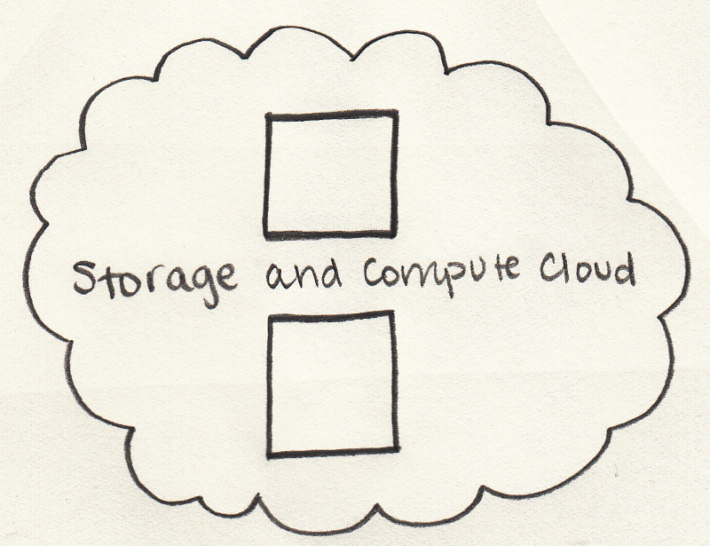
Our Solution

Slide 31
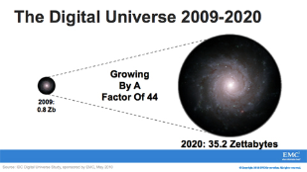
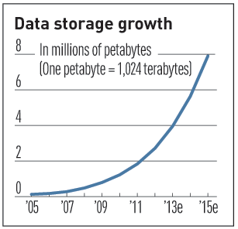

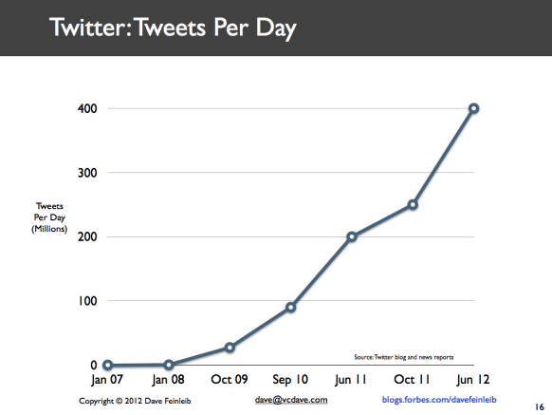
Characteristics of Big Data: 3V’s 1: Volume
Data Volume
44x increase from 2009 2020
From 0.8 zettabytes to 35zb
Data volume is increasing exponentially
Exponential increase in collected/generated data

Slide 32
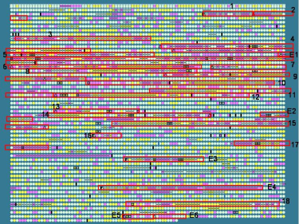
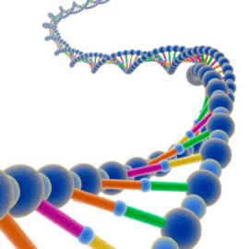
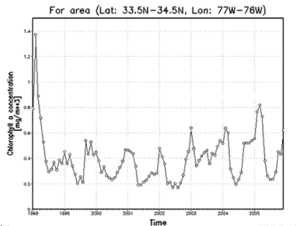

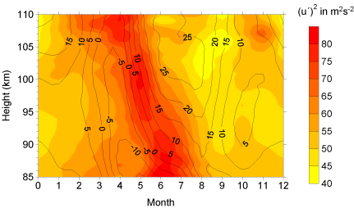

Characteristics of Big Data: 2: Variety (Complexity)
Various formats, types, and structures
Text, numerical, images, audio, video, sequences, time series, social media data, multi-dim arrays, etc…
Static data vs. streaming data
A single application can be generating/collecting many types of data
To extract knowledge➔ all these types of data need to linked together

Slide 33

Characteristics of Big Data: 3 : Velocity (Speed)
Data is begin generated fast and need to be processed fast
Online Data Analytics
Late decisions ➔ missing opportunities
Examples
E-Promotions: Based on your current location, your purchase history, what you like ➔ send promotions right now for store next to you
Healthcare monitoring: sensors monitoring your activities and body ➔ any abnormal measurements require immediate reaction

Slide 34
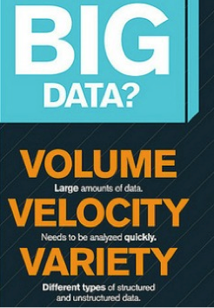

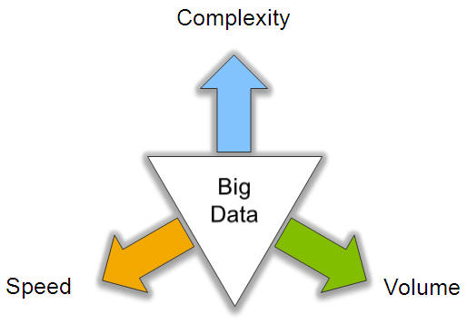
Big Data: 3V’s

Slide 35
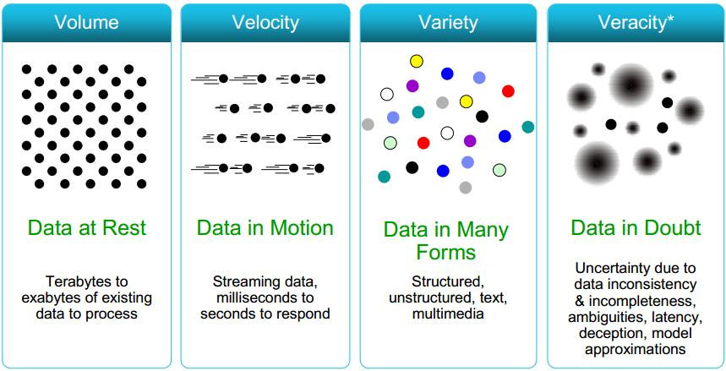
Some Make it 4V’s

Slide 36
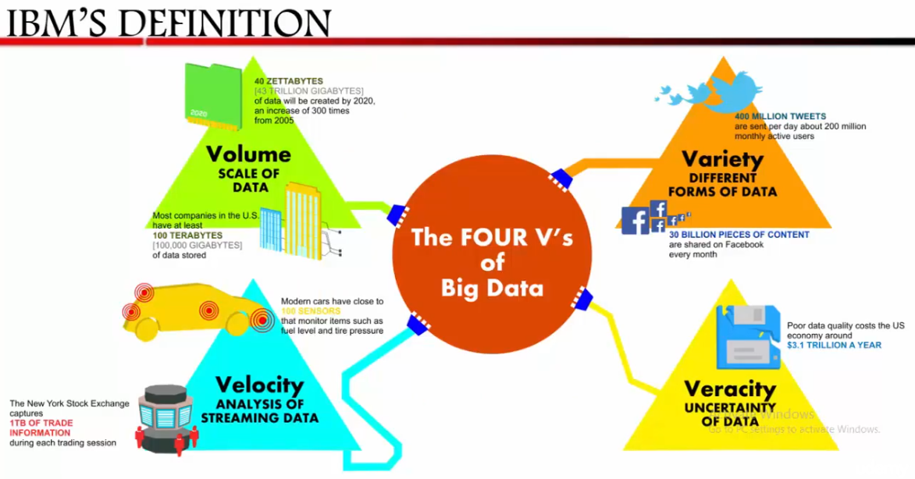

Slide 37
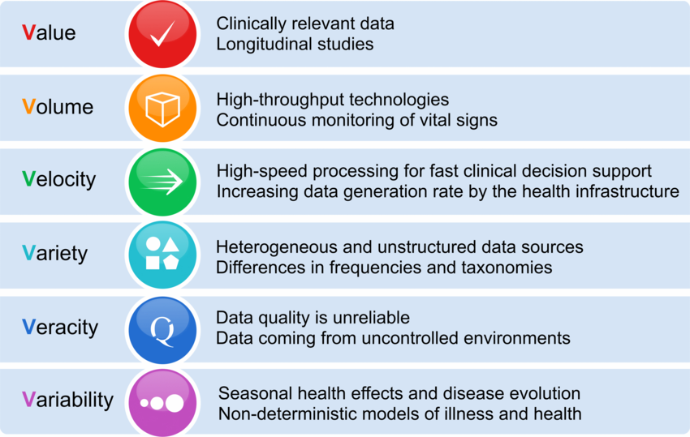

Slide 38
Data Analytics
More Data – Better DSS
Simple Algorithm is more accurate than Sophisticated algorithm if treated with large data set.
Ability to consider 100 parameter than 5.
Write ONCE, Read MANY times..
Data e- Tsunami

Slide 39
IDC 6th Annual Study
From 2005 to 2020 the digital universe will grow by a factor of 300 from 130 exabytes to 40,000 exabytes or 4o trillion GB.
More than 5200 GB for Every man, woman & child in 2020.
From now until 2020 the digital universe will about double every 2 year.
33% of the data might be valuable if analyzed, compared with 25% today.

Slide 40
Quiz:: 1
Currently architecture of DATA Warehouse has the following limitations:-
It can have only limited attributes
It can’t process the data in huge amount
Data warehouse has a predefined static schema
All of the above
Ans: d

Slide 41
Quiz:: 2
Sophisticated algorithm on a smaller training dataset yield better accurate result than a simple algorithm on a larger dataset :-
TRUE
FALSE
Ans: b

Slide 42
Quiz:: 3
The best suited model for data analytic database is “Write once & Read many times”
It is so because once data from the source is captured it would not be much required to be edited but would be needed to be read many times for different Analytical operation.
TRUE
FALSE
Ans: a

Slide 43

What is
Hadoop was created by Doug Cutting, the creator of Apache Lucene, the widely used text search library.
Hadoop has its origins in Apache Nutch, an open source web search engine, itself a part of the Lucene project. Heap automatically tracks every click and swipe taken in your web/mobile app.

Slide 44
Apache Hadoop was Born out of a need to process of Big Data
Hadoop was Created by Doug Cutting and Mike Cafarella in 2005.
Apache Hadoop Software Library is a Framework that perform Distributed Processing of large data sets across Cluster using Simple Programming Models/

Slide 45
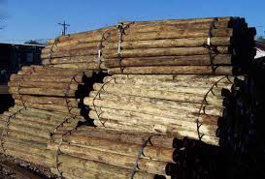
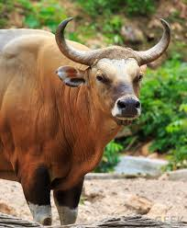

Slide 46


Computing Resource & DATA
Expensive
H/d
Expensive
S/W
High Risk
of Failure

Slide 47





Computing Resource & DATA
HADOOP ADV
Commodity H/d
Free S/W
Reduced Risk of Failure
1o times processing power in 1/10th cost.

Slide 48
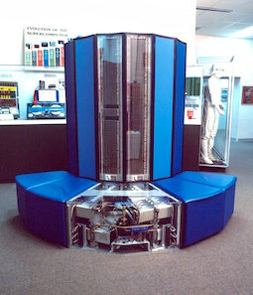
Very high end machines are expensive
Cray Computer

Slide 49
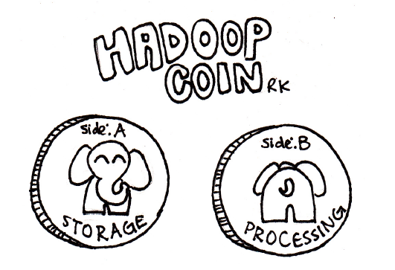

Slide 50
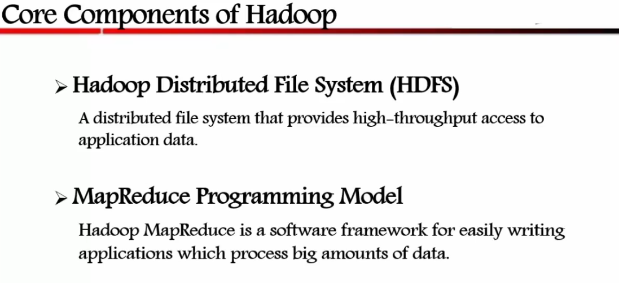

Slide 51
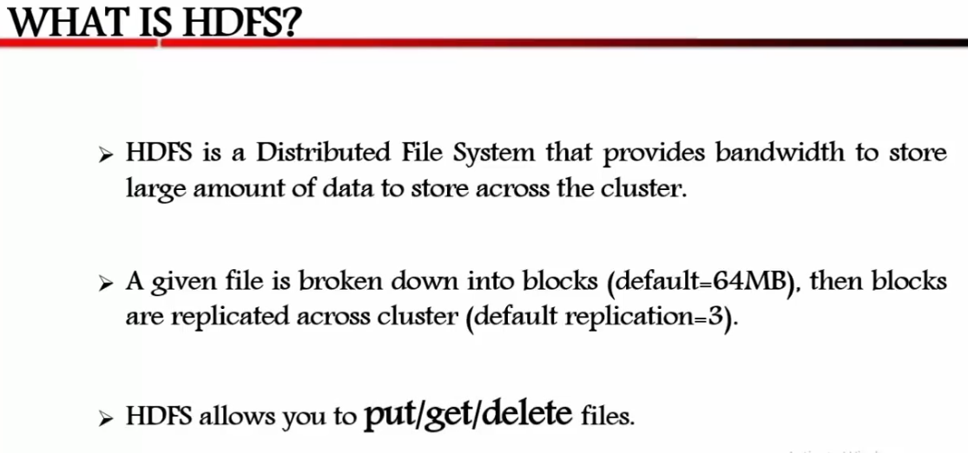

Slide 52
HDFS Features
Commodity hardware
Horizontal scalability
Fault tolerance
HDFS Follows the Philosophy
Write Once and Read Multiple Times
Durability
High Availability
Throughput

Slide 53
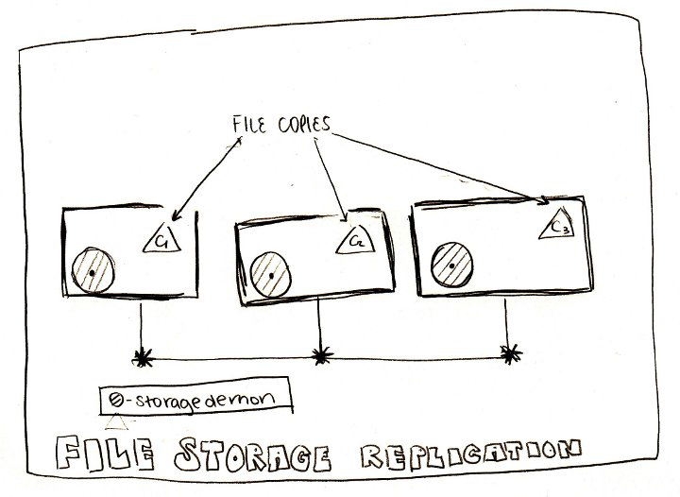
Hadoop solution : Run on commodity hardware
Problem : hardware failure may lead to data loss

Slide 54
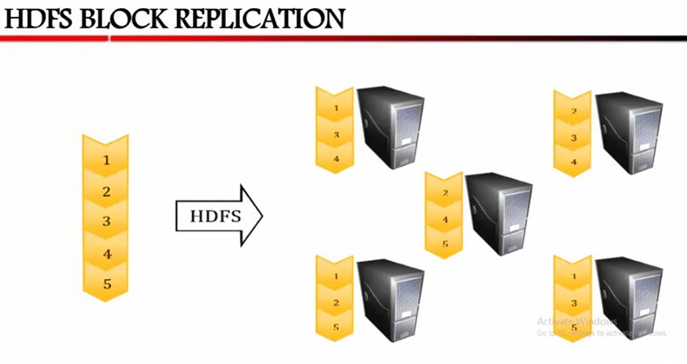

Slide 55
Hadoop clusters scale horizontally
More storage and compute power can be achieved by adding more nodes to a Hadoop cluster. This eliminates the need to buy more and more powerful and expensive hardware.
Hadoop can handle unstructured / semi-structured data
Hadoop doesn't enforce a 'schema' on the data it stores. It can handle arbitrary text and binary data. So
Hadoop can 'digest' any unstructured data easily.

Slide 56
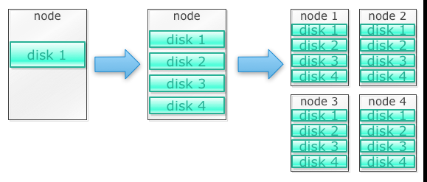
How Hadoop solves the Big Data problem
Hadoop is built to run on a cluster of machines

Slide 57
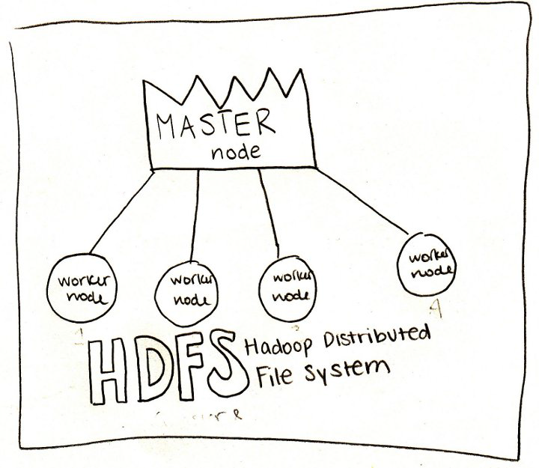
There is a master node that co-ordinates all the worker nodes

Slide 58
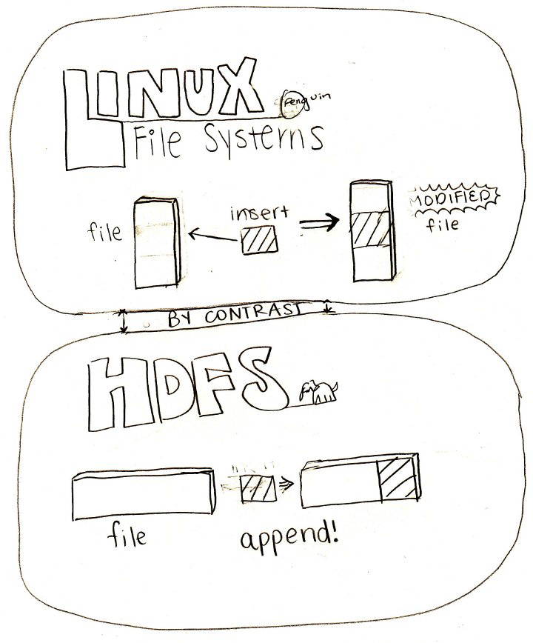
HDFS is better suited for large files
Files are write-once only (not updateable)

Slide 59
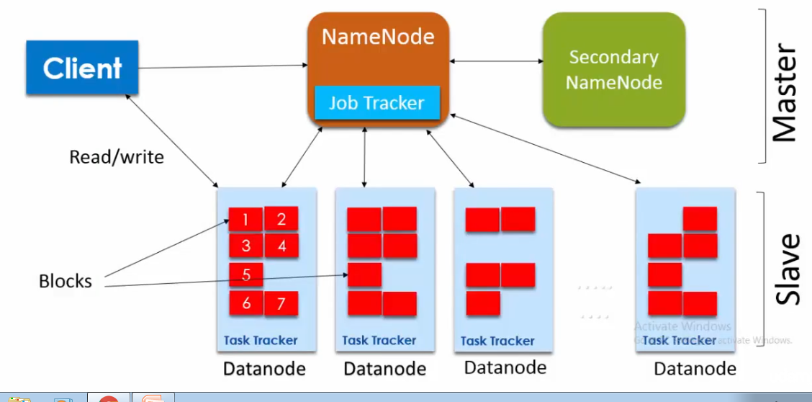
HDFS Architecture

Slide 60
MAPREDUCE
Hadoop MapReduce is S/W framework for easily Writing Applications.
MapReduce is a Programming Model
MapReduce is a Processing Technique and a Programming Model for Distributed Computing based on JAVA.
Map Reduce refers to two Separate and Distinct Task.

Slide 61
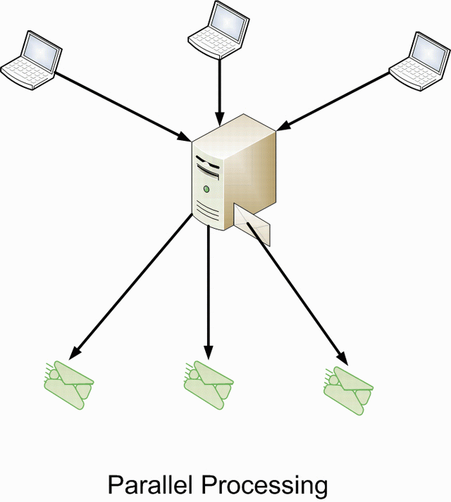
Advantage of Parallelism

Slide 62
Limitations of RDBMS- Seek Time
Seek Time is improving slower than the Transfer Rate .
In 90’s a Drive would be of 1 GB and Transfer Speed would be 4.5 MB/s.
Time Taken To Read the Drive = Total Memory
Speed
= 1000 = 222 Sec.
4.5 (Approx 4 Min.)

Slide 63
Now a Days Drive would be of 1 TB and Transfer Speed would be 100 MB/s.
Find Time Taken to Read the Drive
Time Taken To Read the Drive = Total Memory
Speed
= 1000000 = 10,000 Sec.
100 (Approx 166 Min.)
(Approx 2.8 Hrs)

Slide 64
Business Case for Hadoop
Hadoop provides storage for Big Data at reasonable cost
One study by Cloudera suggested that Enterprises usually spend around $25,000 to $50,000 dollars per tera byte per year. With Hadoop this cost drops to few thousands of dollars per tera byte per year. And hardware gets cheaper and cheaper this cost continues to drop.

Slide 65
Hadoop allows to capture new or more data
One example would be web site click logs. Because the volume of these logs can be very high, not many organizations captured these. Now with Hadoop it is possible to capture and store the logs
With Hadoop, you can store data longer
For example logs for the last 3 months could be stored and older logs were deleted.
With Hadoop it is possible to store the historical data longer. This allows new analytics to be done on older historical data.
For example, take click logs from a web site. Few years ago, these logs were stored for a brief period of time to calculate statics like popular pages ..etc.
Now with Hadoop it is viable to store these click logs for longer period of time.

Slide 66
Hadoop provides scalable analytics
There is no point in storing all the data, if we can't analyze them. Hadoop not only provides distributed storage, but also distributed processing as well. Meaning we can crunch a large volume of data in parallel.
The compute framework of Hadoop is called Map Reduce. Map Reduce has been proven to the scale of peta bytes.
Hadoop provides rich analytics
Map Reduce supports Java as primary programming language.
Other languages like Ruby, Python and R can be used as well.
For example a tool named Pig takes english like data flow language and translates them into Map Reduce. Another tool Hive, takes SQL queries and runs them using Map Reduce.
Business Intelligence (BI) tools can provide even higher level of analysis. Quite a few BI tools can work with Hadoop and analyze data stored in Hadoop.

Slide 67

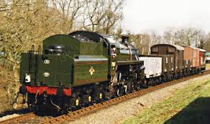
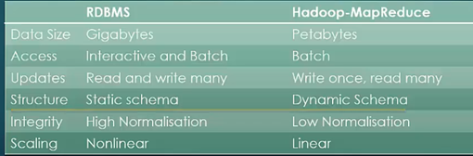
Traditional Management System Vs HADOOP

Slide 68
Quiz:: 4
Which of the following attribute is an advantage of RDBMS – Single Server architecture over Hadoop Cluster deployment
Hardware Cost – for an equal throughput RDBMS single server deployment would be cheaper than Hadoop Cluster.
Software Cost – RDBMS software's are cheaper than Hadoop Cluster
Risk of Failure – It is less probable in RDBMS single server architecture implementation as best in class hardware Used.
RDBMS is an Interactive and Has ability of many of many read and Write but Hadoop follow Write Once & Read many Times.
Ans: d

Slide 69
Quiz:: 5
Should Hadoop deployment be considered for to Replace RDBMS as an OLTP for a Normal Business::
TRUE
FALSE
Ans: b

Slide 70
Quiz:: 6
In a Distributed architecture an Individual Component will fail more Frequently ::
TRUE
FALSE
Ans: a

Slide 71
Quiz:: 7
Distributed architecture implies reduced risk of failure as Hardware failure would degrade the performance but not bring the system to stand still
TRUE
FALSE
Ans: a

Slide 72
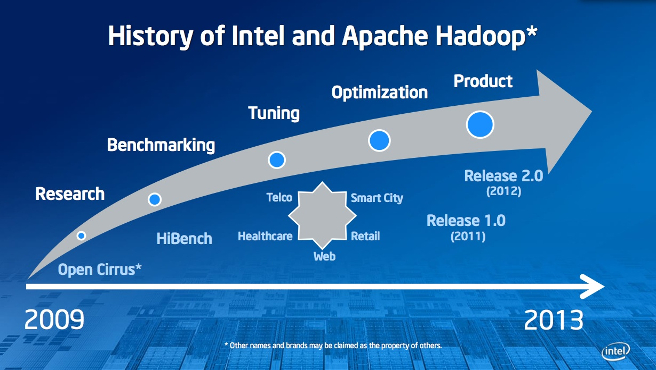
Hadoop Releases::

Slide 73
What skills do I need to learn Hadoop?
A hands-on developer or admin can learn Hadoop.
The following list is a start - in no particular order
Hadoop is written in Java. So knowing Java helps
Hadoop runs on Linux, so you should know basic Linux command line navigation skills
Some Linux scripting skills will go a long way

Slide 74
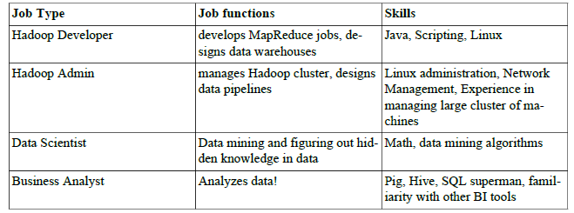
What kind of technical roles are available in Hadoop?
I am not a programmer, can I still use Hadoop?

Slide 75
What Technology Do We Have
For Big Data ??

Slide 76
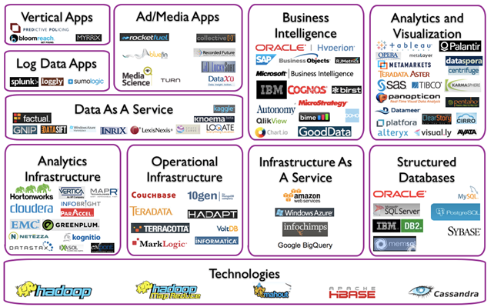
Big Data Landscape

Slide 77

Big Data Technology

Slide 78
Characteristics of Hadoop
Accessibility
Robustness
Scalability
Fault-tolerance

Slide 79

Will you Join HADOOP DANCE ?

Slide 80

Meet the Hadoop Zoo

Slide 81
HBase, the database for Big Data

Slide 82
ZooKeeper

Slide 83
MapReduce

Slide 84
Hive - data warehousing

Slide 85
Pig - Big Data manipulation
Hi..
"I am Pig, I let you move HDFS cages around, and I speak Pig Latin."

Slide 86
Course Logistics

Slide 87
Thank You.

